Slide 1
STRATEGIC PLANNING TEAM UPDATE
June 15, 2022
Our Connectional Church: Conversations with the Strategy Team

Slide 2
Strategy Team Members
Terri Sherman – facilitator- First Pres Lincoln
Suzie Harder – note taker – Southern Heights Lincoln
Charity Potter – Thurston and Wakefield
Thomas Dummermuth – Eastridge Lincoln
Steve Piper – Palmyra
Wendy Wait – Gresham
Stephen Earl – Interim EP

Slide 3
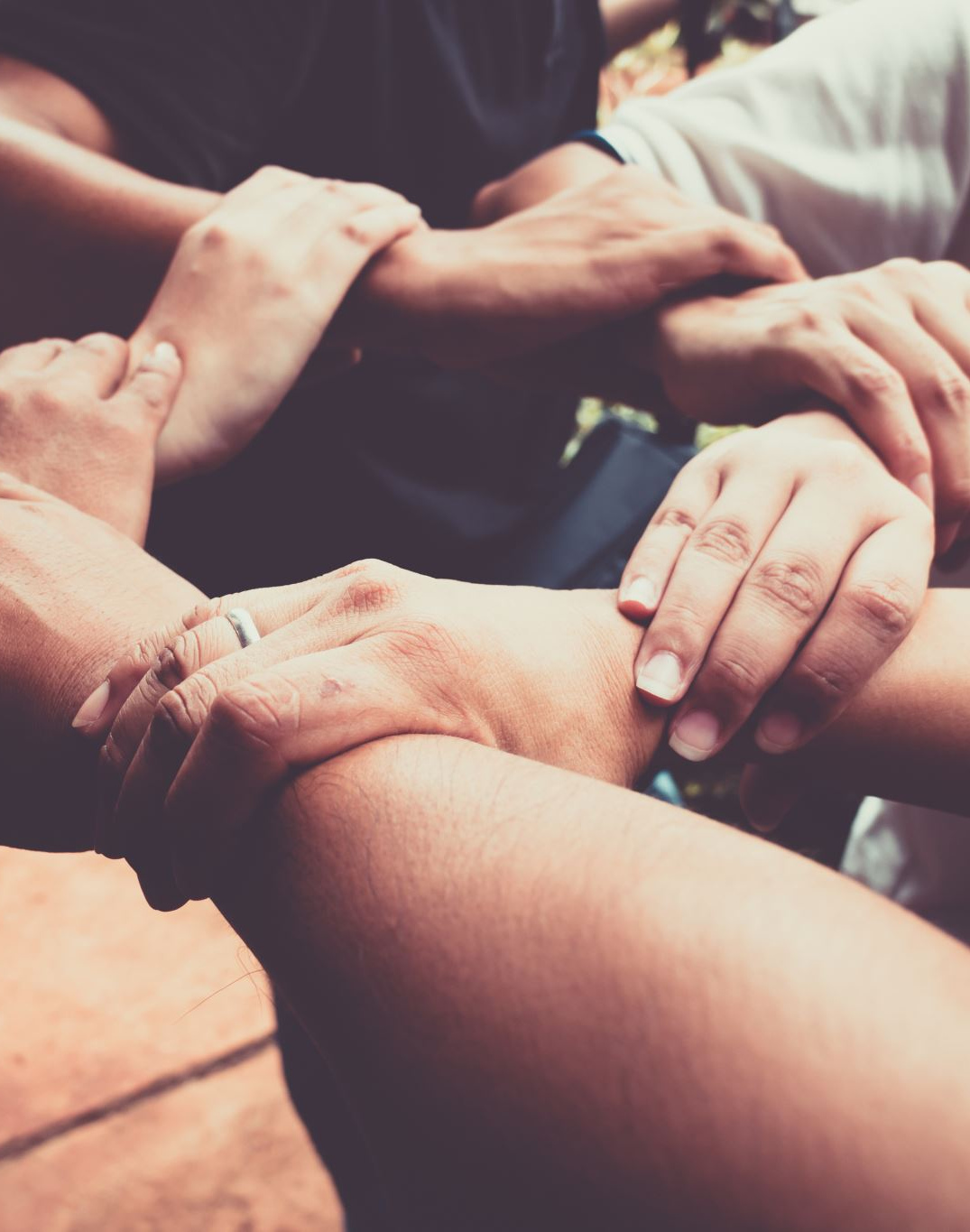
Values that Represent Homestead Presbytery
Connectedness
Hopefulness
Outreach
Creativity

Slide 4
Why We Do What We do? Mission Statement of Homestead Presbytery
The Mission of God calls us to:
Empower Congregations
Connect Communities
Equip the people of God.

Slide 5
How Do We Move Forward?
Rushing to the finish line by May.
After Hearing the Report from Leaderwise we realized we needed to slow down and spend time on relationship based needs in our Presbytery.
Their specific recommendations were:
Hold a guided experience of confession, repentance, and reconciliation.
Pursue trust building within the presbytery
Discern a new unifying purpose for the presbytery
Guide COM through a reboot of purpose and process
Explore meaningful avenues for connection within the Presbytery
Bridge the urban/rural north/south divide.
This is the work of our primary focus.

Slide 6
Pursue trust building within the Presbytery
We spent a considerable amount of time at the May meeting of Presbytery discussing this mission and building relationships.
We hope to do more of these at future Presbytery meetings.

Slide 7
Other items
The COM has begun a reboot and will be holding a 2 day retreat for training and re-tooling
A time for confession, repentance and reconciliation is being planned for this summer / early fall
Three Presbytery-wide Zoom calls: June 15th, Sept 18th and Dec 8th

Slide 8
Staffing Model
3 Part Time Regional Presbyters
Each Presbyter would represent a region of the Presbytery – north, central and south
3 Facilitating Presbyters all at around – 20 hrs/wk
Volunteer Treasurer
Duties relating to the Stated Clerk and Administrative Assistant are yet to be determined.

Slide 9
HOMESTEAD PRESBYTERY TEAMS
Reconciliation and Trust
Congregational Network
Expert Connect
Companions for the Journey
Steering the Ship
Permanent Judicial Commission

Slide 10
Thank you!
Thank you for attending todays Zoom call. We want all our congregations to feel a part of the rebuilding process in the presbytery and your being here shows you care and want to be part of the solution.

Slide 11
Conversation time
“Work willingly at whatever you do, as though you were working for the Lord rather than for people. Remember that the Lord will give you an inheritance as your reward, and that the Master you are serving is Christ.” Colossians 3:23-24

